Slide 1
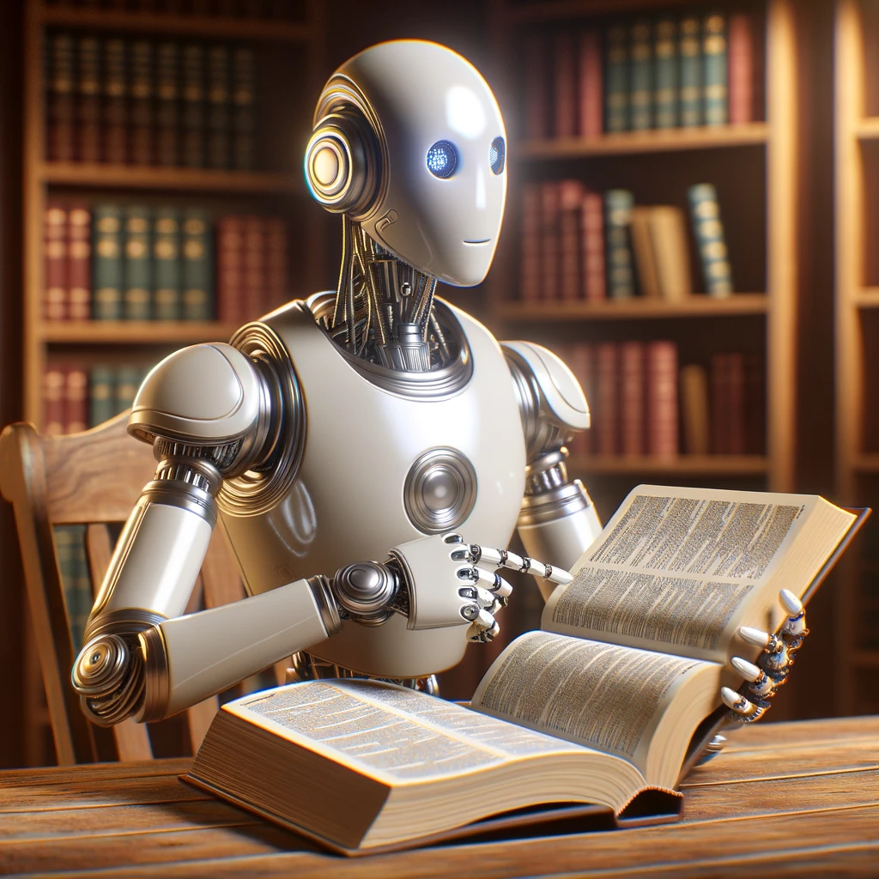
AI Key terms

Slide 2
Model
A model is a computer program that has been trained on a large amount of data to perform a specific task, such as recognizing images, translating languages, or making predictions, without being explicitly programmed with rules for that task.

Slide 3
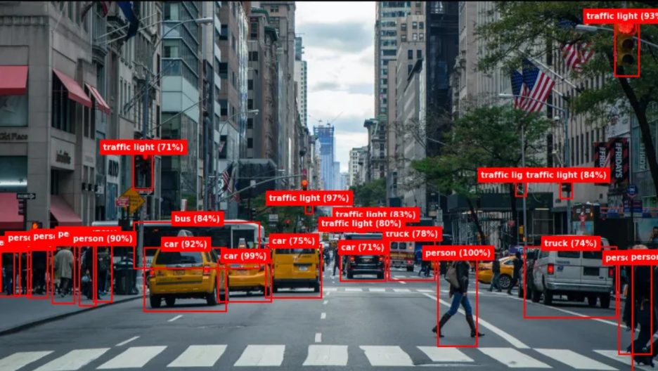

Slide 4
Generative AI
Generative AI refers to a type of artificial intelligence that can create new content, ranging from text and images to music and video, based on patterns it learns from existing data. These systems use their training to generate outputs that are novel yet realistic, such as writing stories, composing music, or designing graphics. This capability makes generative AI a powerful tool for a variety of applications, including entertainment, design, and automation, where it can produce original, creative work.

Slide 5
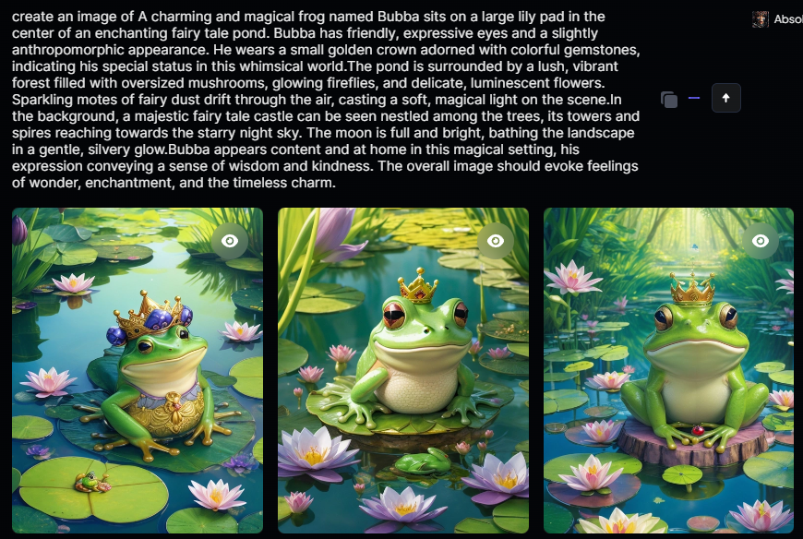

Slide 6
Large language model (LLM)
A large language model is a complex artificial intelligence system trained on a massive dataset of text and code, enabling it to understand and generate human-like text, translate languages, write different kinds of creative content, and answer your questions in an informative way, even if they are open ended, challenging, or strange.

Slide 7
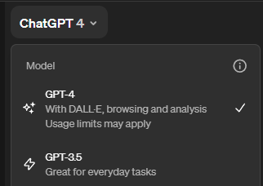

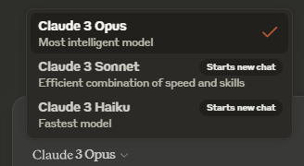

Slide 8
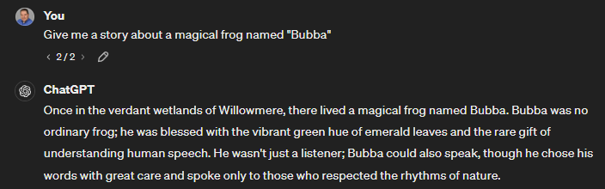

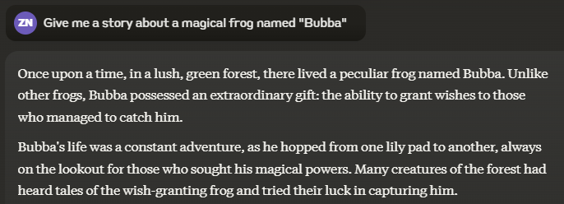


Slide 9
Prompt Engineering
Prompt engineering involves crafting the instructions or questions you give to an AI model to get the best possible answers or outputs. It's a bit like figuring out the right way to ask a question so that you get the most useful and relevant information in return. By fine-tuning these prompts, users can guide the AI to generate more accurate, creative, or specific responses based on their needs.

Slide 10



Slide 11
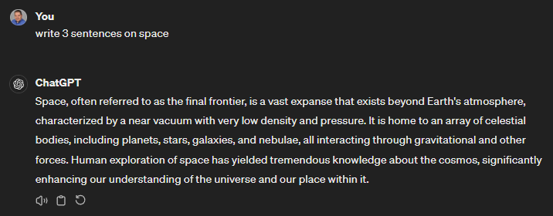
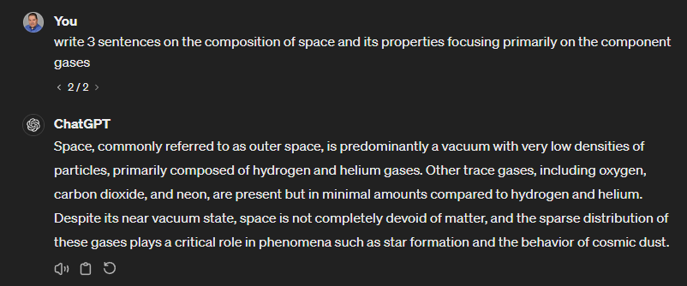

Slide 12
Natural Language Processing (NLP)
Natural Language Processing, or NLP, is a field of AI that focuses on enabling computers to understand and interact using human language. This technology powers things like voice-activated assistants, translation services, and email filters by analyzing and responding to text and speech. NLP helps bridge the communication gap between humans and machines, making it easier for us to use technology in everyday tasks.

Slide 14
Neural networks
Neural networks are a type of AI inspired by the human brain, designed to recognize patterns and make decisions. They consist of layers of interconnected nodes, or "neurons," that process information by passing signals to each other, much like how neurons communicate in our brains. These networks learn from large amounts of data, gradually improving their accuracy in tasks like image recognition, language translation, and more, as they adjust connections based on the results they produce.

Slide 15
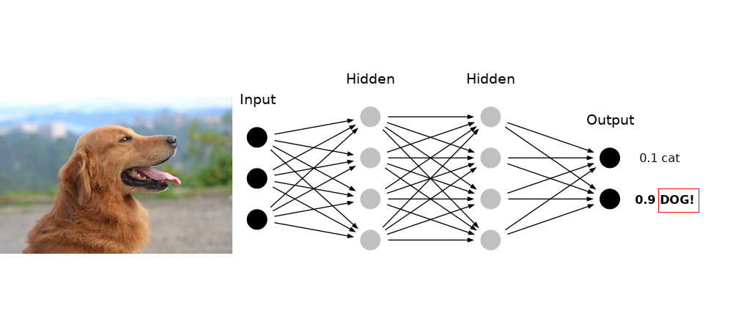

Slide 16
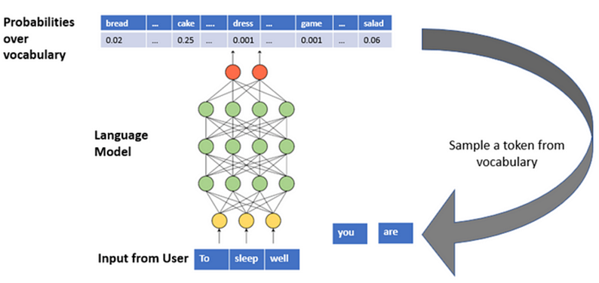

Slide 17
Agentic ai (Aka “Ai agents”)
Agentic AI represents a significant evolution in artificial intelligence, designed to act more like a human colleague than just a tool. Unlike traditional AI, which performs repetitive tasks, agentic AI can understand complex instructions, make its own decisions, and adapt to new situations without needing constant human guidance. This advanced AI can independently manage workflows and respond proactively to changes, making it a powerful asset in various industries by improving efficiency and decision-making.

Slide 18
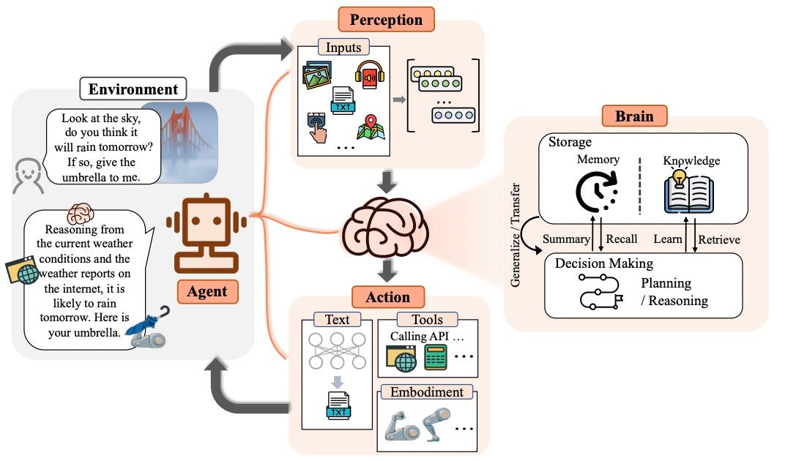

Slide 19
